Slide 1

Load Detection Techniques using High Frequency Features on Embedded Systems
Master Thesis Presentation
Hugo Wöhrl
University of Bologna
Department of Electrical, Electronic and Information Engineering
Supervisor: Prof. Luca Benini, Dr. Davide Brunelli

Slide 2
Table Of Contents
Introduction to Non-Intrusive Load Monitoring
The Smart Measurement Node
Hardware
Firmware
Software Tools
Data Acquisition
Features
Training and Classification
Evaluation

Slide 3
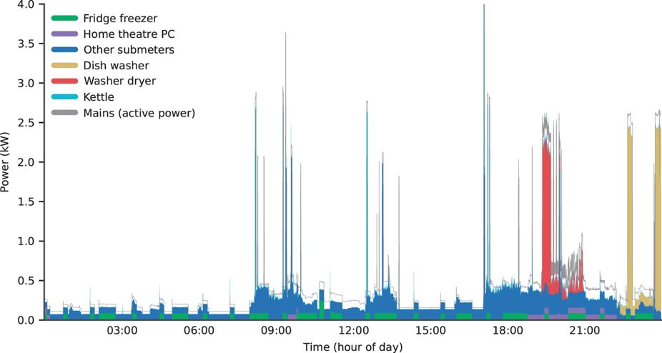
Introduction to NILM
NILM is the task of extracting energy consumption from an agglomerated power signal
NILM founded in the mid 80s by G.W. Hart at MIT
Smart Meter Roll out in several countries increased interest massively
Most research focuses on Smart Meter generated Data (1 Hz Power Measurements)
In older publications mostly statistical methods as Hidden Markov Models
Kelly published in 2015 “Neural NILM”, which was a kickoff for using Neural Networks in the Field of NILM
Introduction of Smart Meters experienced a Backlash due to Privacy Concerns in the UK
Power Plot over one day from the open UK-Dale Dataset
[The UK-DALE dataset, domestic appliance-level electricity demand and whole-house demand from five UK homes]

Slide 4
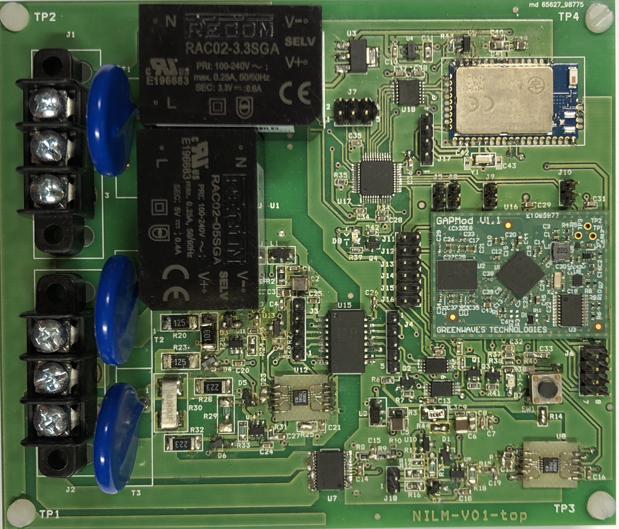
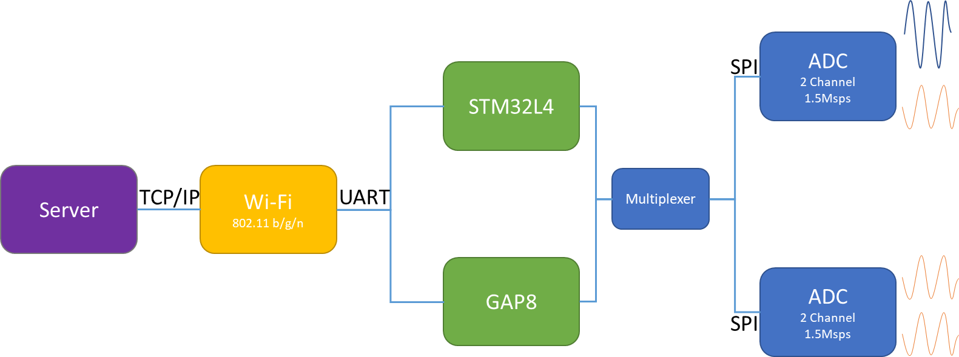
The Smart Measurement Node
Development Kit for Non-Intrusive Load Monitoring Applications
Two Analog Interfaces
Simultaneous Sampling @ 1.5MSps
14Bit Resolution
Invasive and Non-Invasive Measurements possible
Two MCUs
STM32F410x8 → Data Acquisition
GreenWaves GAP8 → Offline Real Time Classification
Wi-Fi Module
Tested Bandwidth: 100kB/s
→ Data Transmission Rate of 25kHz for 2 Channels

Slide 5
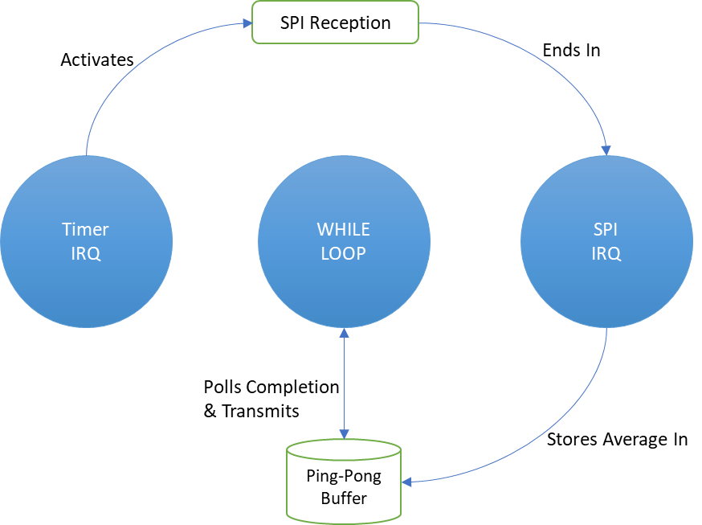
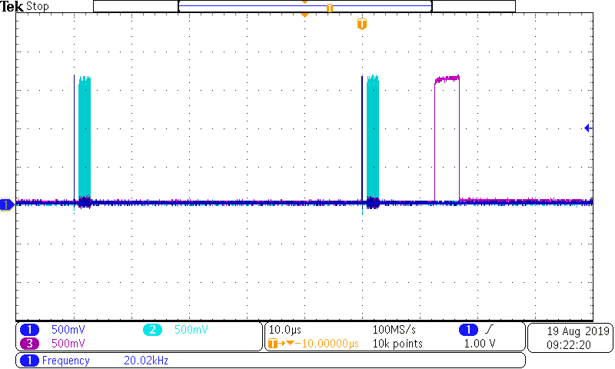
Firmware
Configure:
Clocks, GPIOs, Timers
DMAs, Interrupts
MCU
Initialization
Initialize Wi-Fi Module
Establish Connection
Instantiate Measurement
Device
Initialization
Processes of Continuous Operation
Perform Measurement
Form Average
Fill Ping-Pong Buffer
Send Full Ping-Pong Buffer
Continuous
Operation
Flow Chart of Firmware
Source Code online available:
https://github.com/fabianhugo/nilm-stm32f4-daq
Oscilloscope Plot of Conversion Signals: (1) = Timer1; (2) SPI Clock; 3 Storage Complete

Slide 6
Software Tools
Tool Pipeline:
Data Set Recorded Via TCP/IP Socket
Manually Labelled using Plots of Current Traces
Features are extracted from Time Series and stored to .csv
Classifiers: Support Vector Machine Classifier (SVC), k-Nearest Neighbor (kNN), Multi Layer Perceptron (MLP), Random Forest Trees (RFT)
All tools written in Python3, based on Scikit-Learn and Pandas
Logging
Labelling
Feature Extraction
Training and Classification

Slide 7
Data Acquisition
8 Appliances of 3 different types
On/Off Appliances: Incandescent Light Bulb, Electric Kettle, Fan(3 States), Fluorescent Light =6
Finite-State-Machine Appliances: Microwave (3 States) =3
Continuously Variable Loads: Laptop, Monitor, Cellphone Charger =3
→ 12 Classes + 1 ‘No Load’ Class
5 Different Scenarios:
Single Appliances without Switching Events
Single Appliances with Switching Events
Multi Appliance Recording
Without Superposition of Loads
With Superposition of Loads
Extended Single Appliance Detection
Switching Event Collection
For Extended Single Appliance Detection 10 Laptop States were added → 23 Classes
Recordings were repeated to create a robust dataset and to cover different appliance states and states of the grid
Dataset available online:
https://github.com/fabianhugo/nilmdata

Slide 8
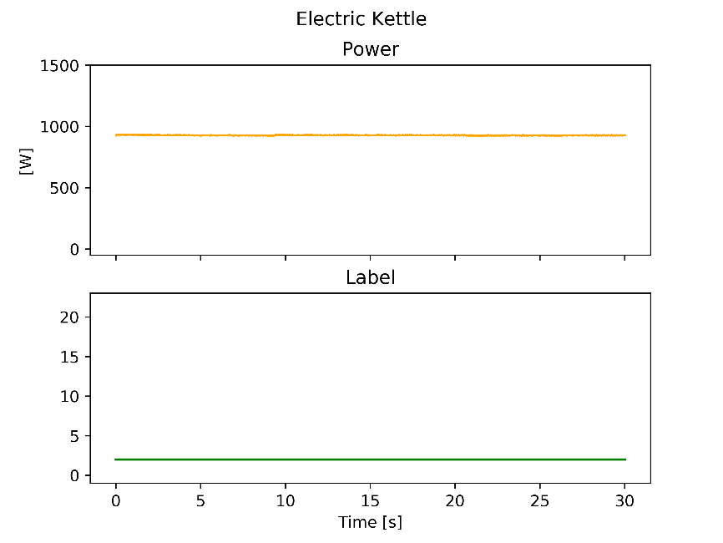
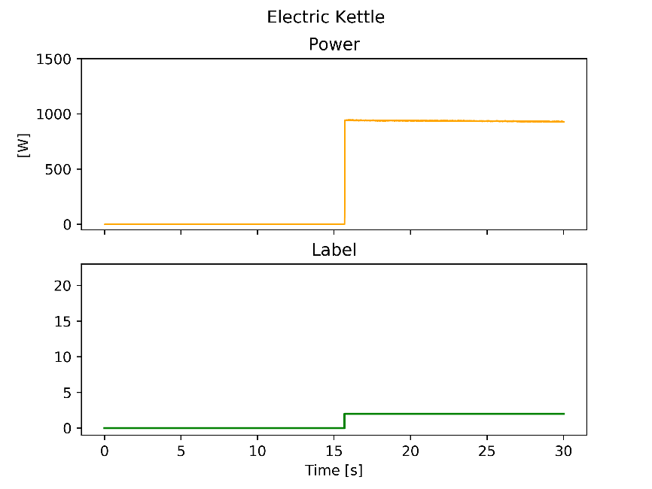
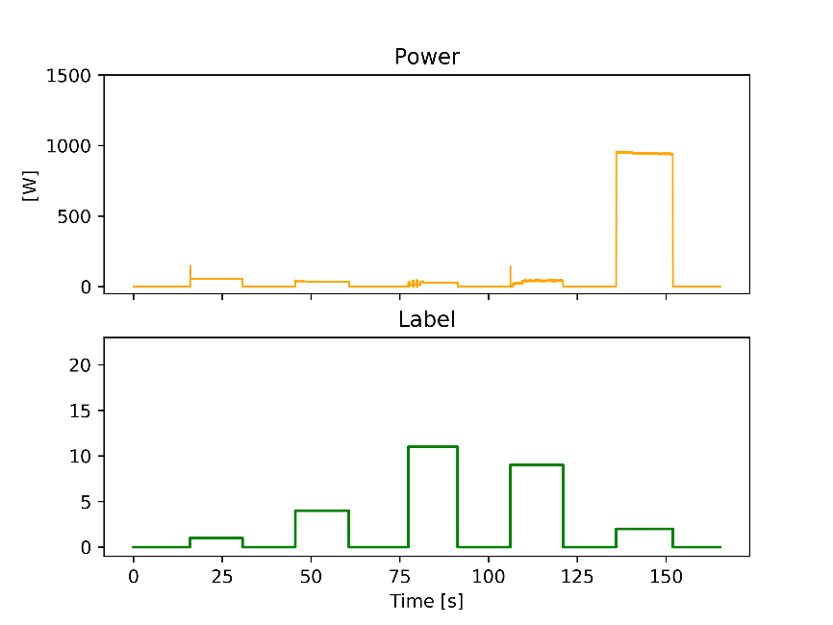
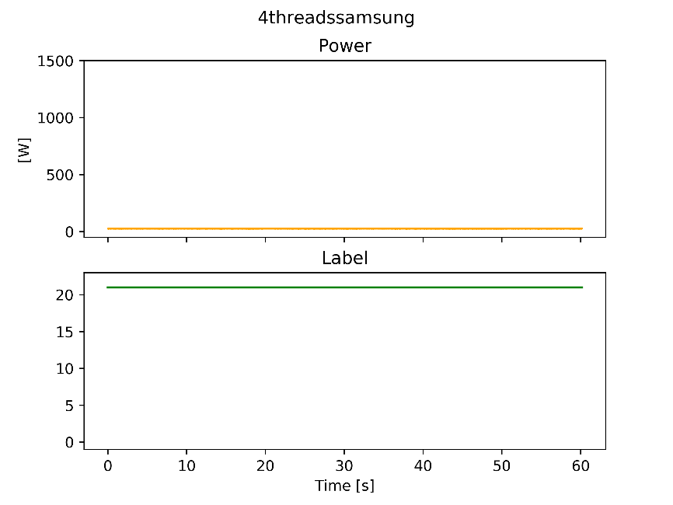
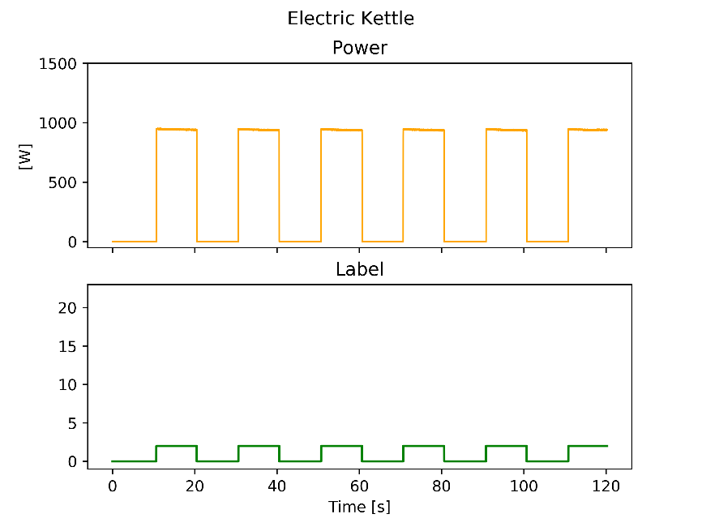
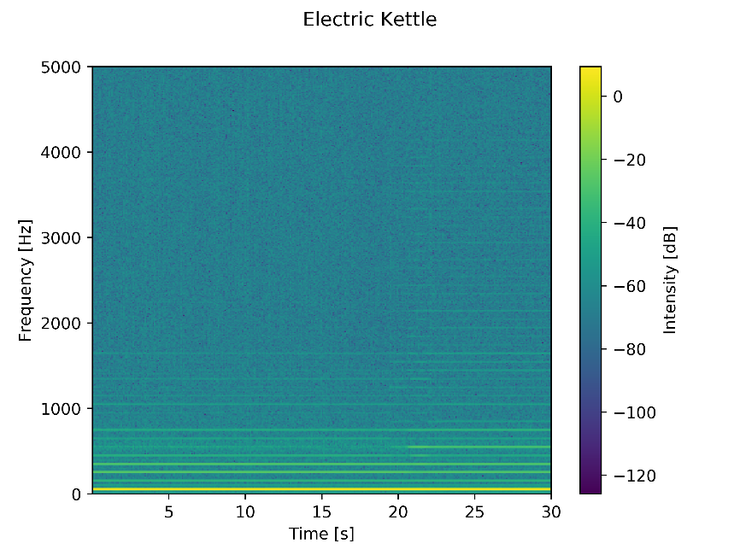
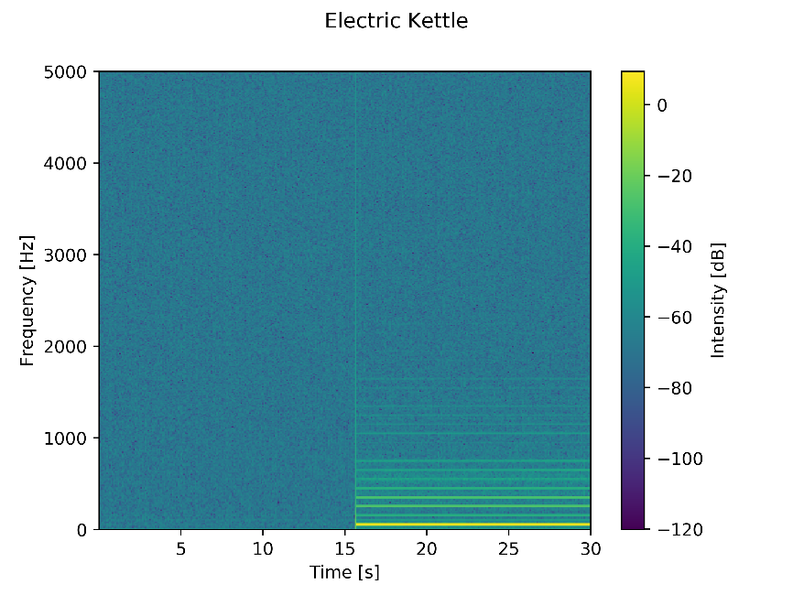
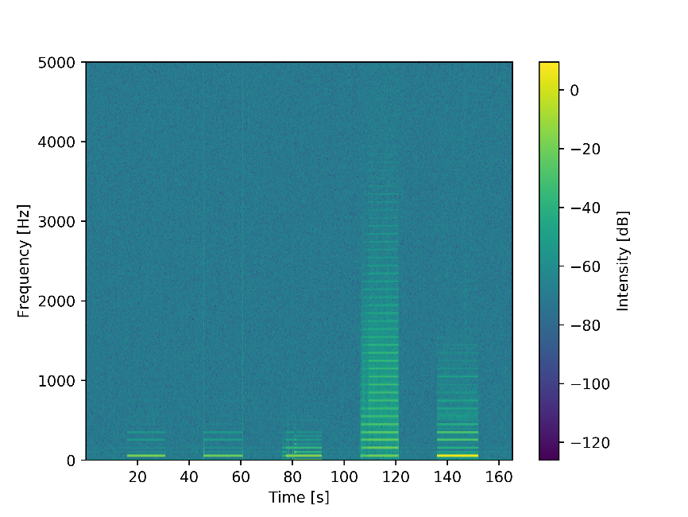
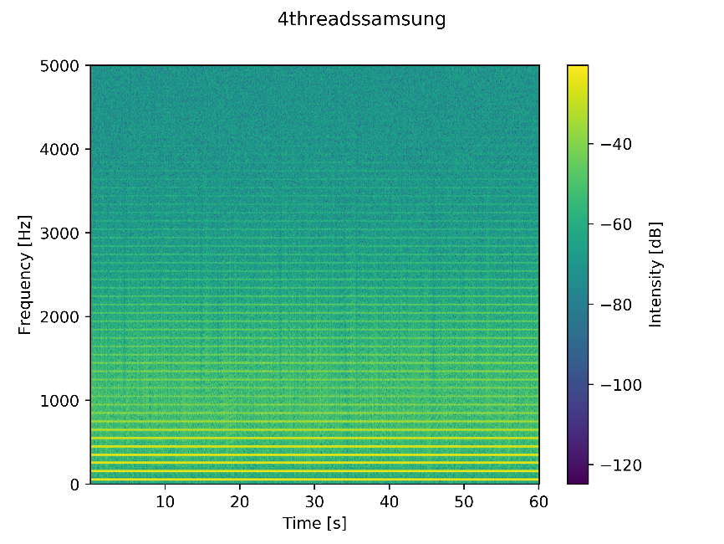
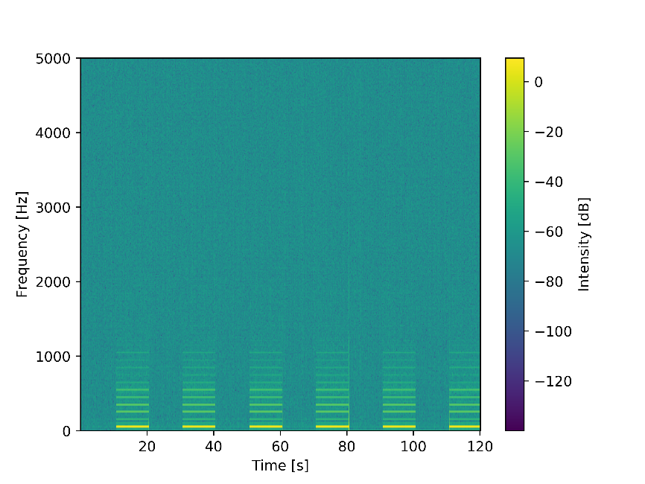
Data Acquisition: Recorded Scenarios
1 Single Appliances without Switching Events | 2 Single Appliances with Switching Events | 3 Multi Appliance Recording (with and without Superposition) | Extended Single Appliance Detection | Switching Event Collection
30s | 30s | 150s | 60s | 30s

Slide 9
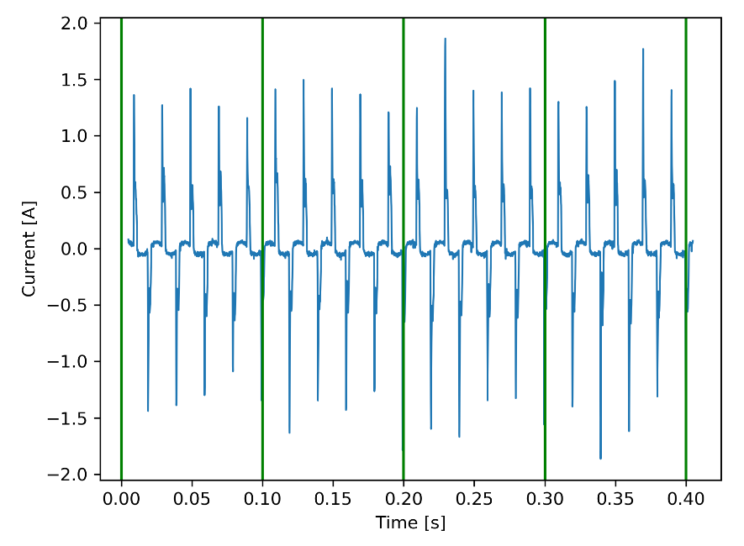
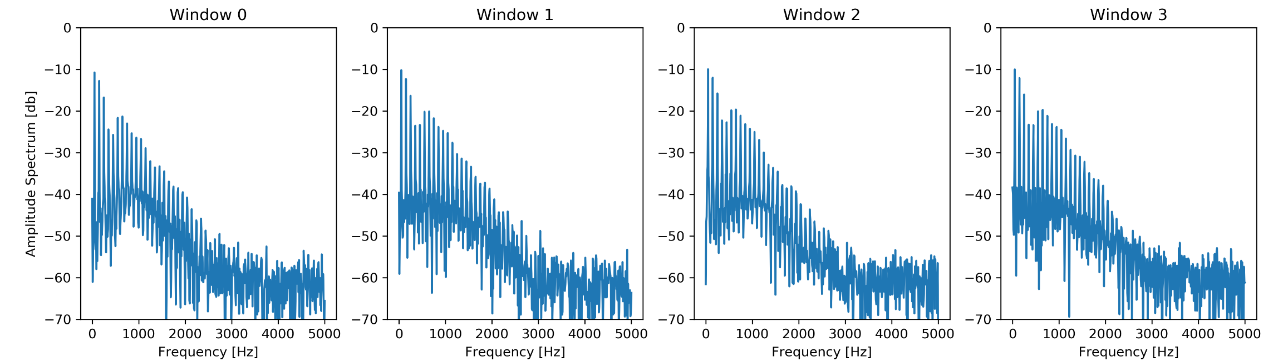
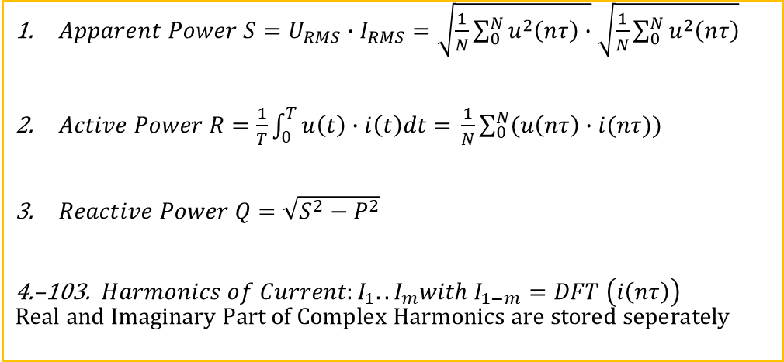

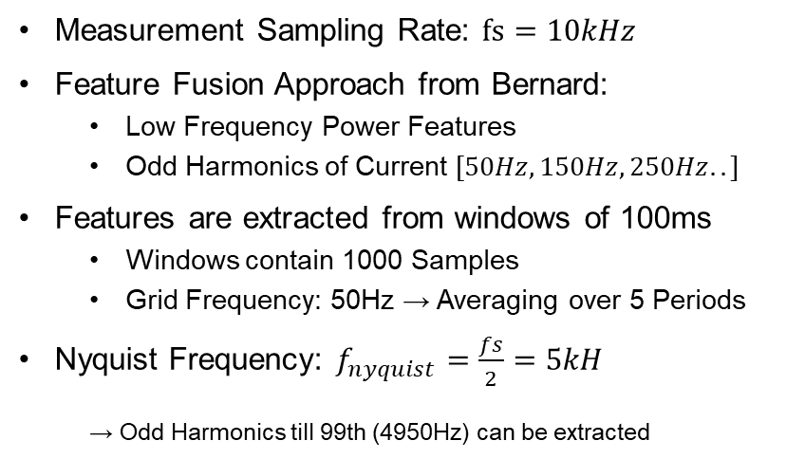
Features
$Apparent Power S=U_{RMS}∙I_{RMS}=\sqrt{\frac{1}{N}\sum_{0}^{N}{u^{2}\left(nτ\right)}∙}\sqrt{\frac{1}{N}\sum_{0}^{N}{u^{2}\left(nτ\right)}}$
$Active Power R=\frac{1}{T}\int_{0}^{T}{u\left(t\right)∙i\left(t\right)dt= }\frac{1}{N}\sum_{0}^{N}{(u\left(nτ\right)∙i(nτ))}$
$Reactive Power Q=\sqrt{S^{2}−P^{2}}$
4.–103. $Harmonics of Current:I_{1}..I_{m}with I_{1−m}=DFT \left(i\left(nτ\right)\right)$ $$Real and Imaginary Part of Complex Harmonics are stored seperately$$
Measurement Sampling Rate: $fs=10kHz$
Feature Fusion Approach from Bernard:
Low Frequency Power Features
Odd Harmonics of Current $[50Hz, 150Hz, 250Hz..]$
Features are extracted from windows of 100ms
Windows contain 1000 Samples
Grid Frequency: 50Hz → Averaging over 5 Periods
Nyquist Frequency: $f_{nyquist}=\frac{fs}{2}=5kH$
→ Odd Harmonics till 99th (4950Hz) can be extracted
$$DFT$$
Current Trace of Laptop without Switching Event
Transformed Current Spectrum of 100ms windows

Slide 10
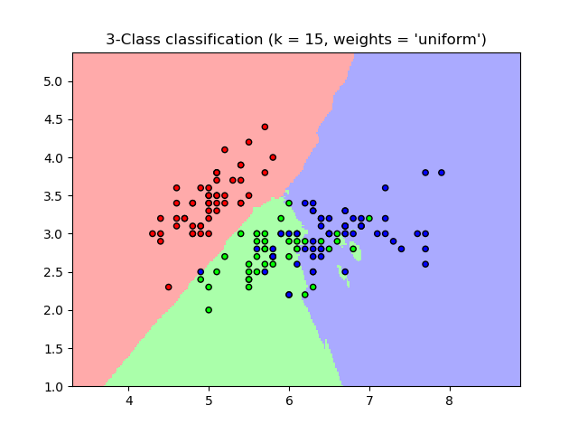
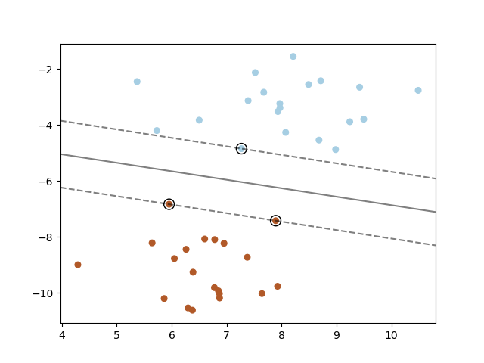

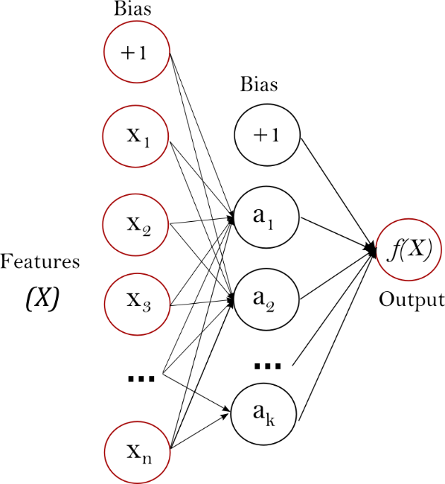
Training and Classification Procedure
Load features and labels from dataset(s)
Perform grid search to find best algorithm and hyper parameters on training dataset
Split dataset into test- and training dataset
Use 10-fold Cross validation to affirm classification result
Train Model on best algorithm and best hyper parameters
Load unseen dataset and validate performance
k Nearest-Neighbor Classifier
Support Vector Machine Classifier
[scikit-learn,kNN]
[scikit-learn, SVM]
Random Forest Tree Classifier
Multi-Layer Perceptron Classifier
[wikipedia, Decision Tree]
[scikit-learn, Neural Networks]

Slide 11
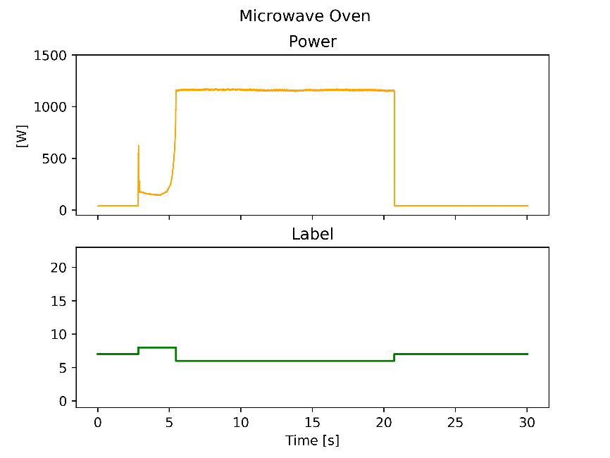
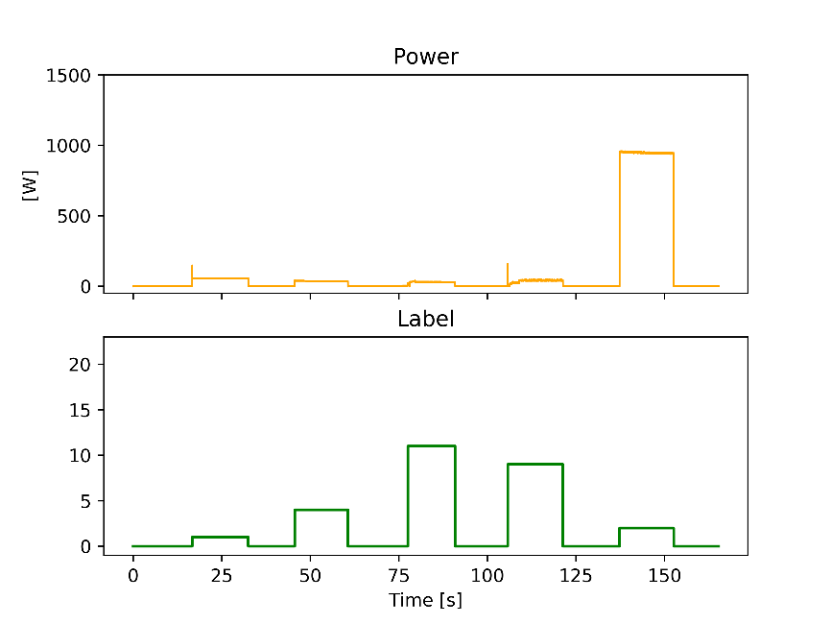
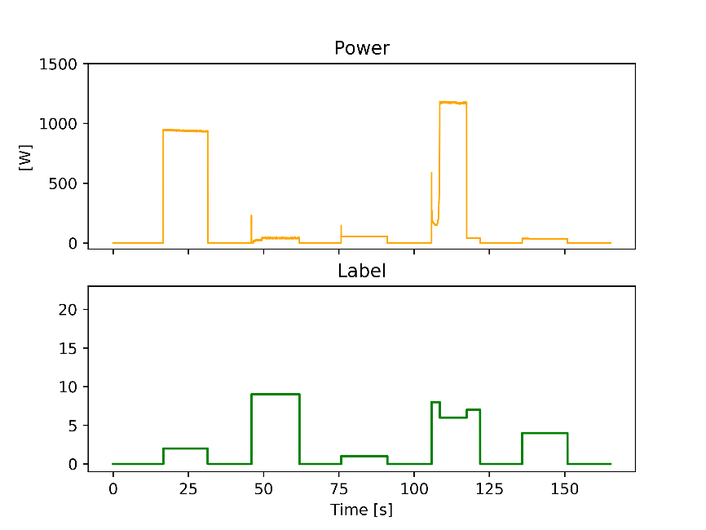
1 Eventless Classification
Training and Validation on Scenario 1 Dataset: Single Appliances Without Switching Events
Evaluation on Dataset 3:
Multi-Appliance Recordings Without Switching Events
Switching Order00:
Heatbulb, Fan2, Fluorescent Light, Laptop, Kettle
Switching Order02:
Kettle, Laptop, Heatbulb, Microwave, Fan2,
5 Repetitions of 30s-Recordings of 13 Classes
Window size: 100ms
→ Dataset contains ca. 20 000 labelled Instances
Dataset contains 150s-recordings of different combinations of appliances switching on and off consecutively.
Dataset is not used during training

Slide 12
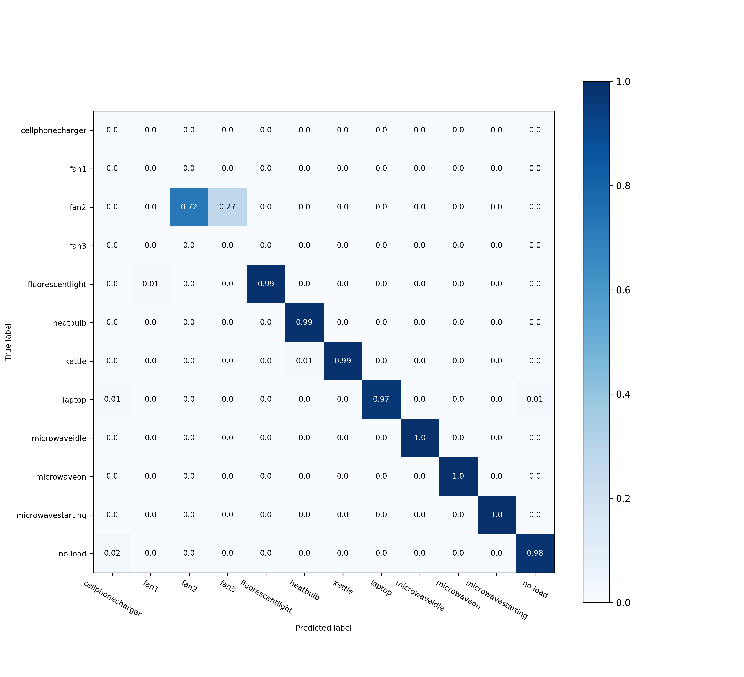
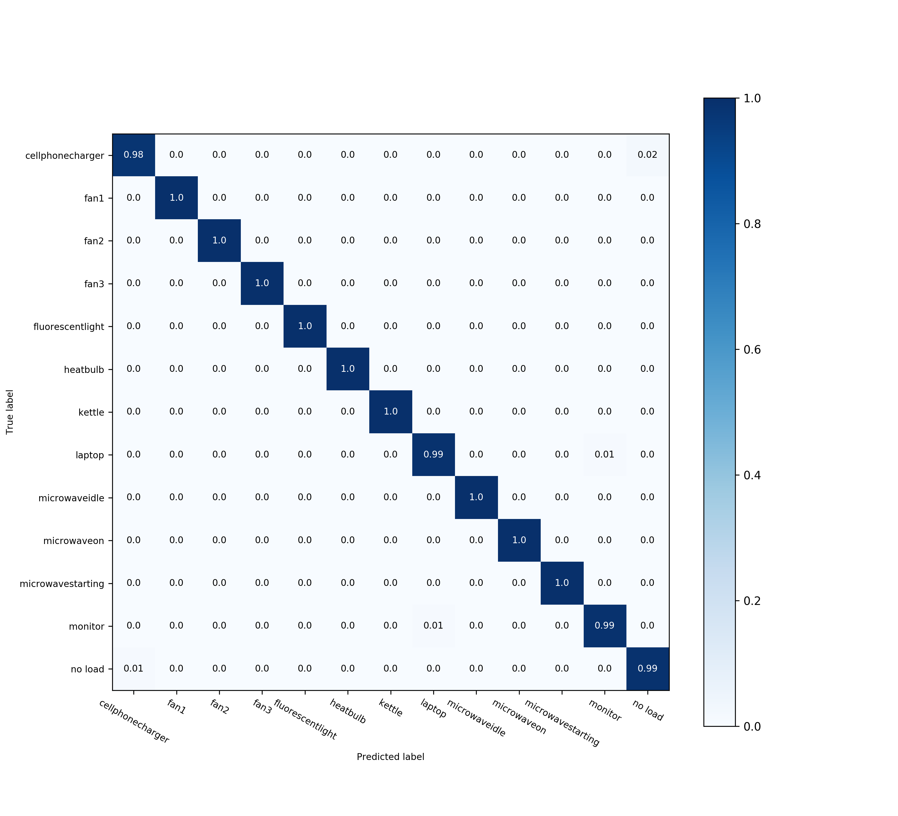
Evaluation 1: Eventless Classification
Best Classification of13 Classes with SVC @ C=1, gamma = 0.0001 and a linear kernel.
MLP-Classifier, Random Forest and k-NN perform only slightly worse
On Test Dataset of Model
On Scenario 3.1
Normalized Confusion Matrix
Normalized Confusion Matrix
Accuracy= 99.33%
Precision= 99.33%
Recall = 99.33%
F-Beta Score = 99.32%
Accuracy= 95.83%
Precision= 99.55%
Recall = 95.83%
F-Beta Score = 97.47%

Slide 13
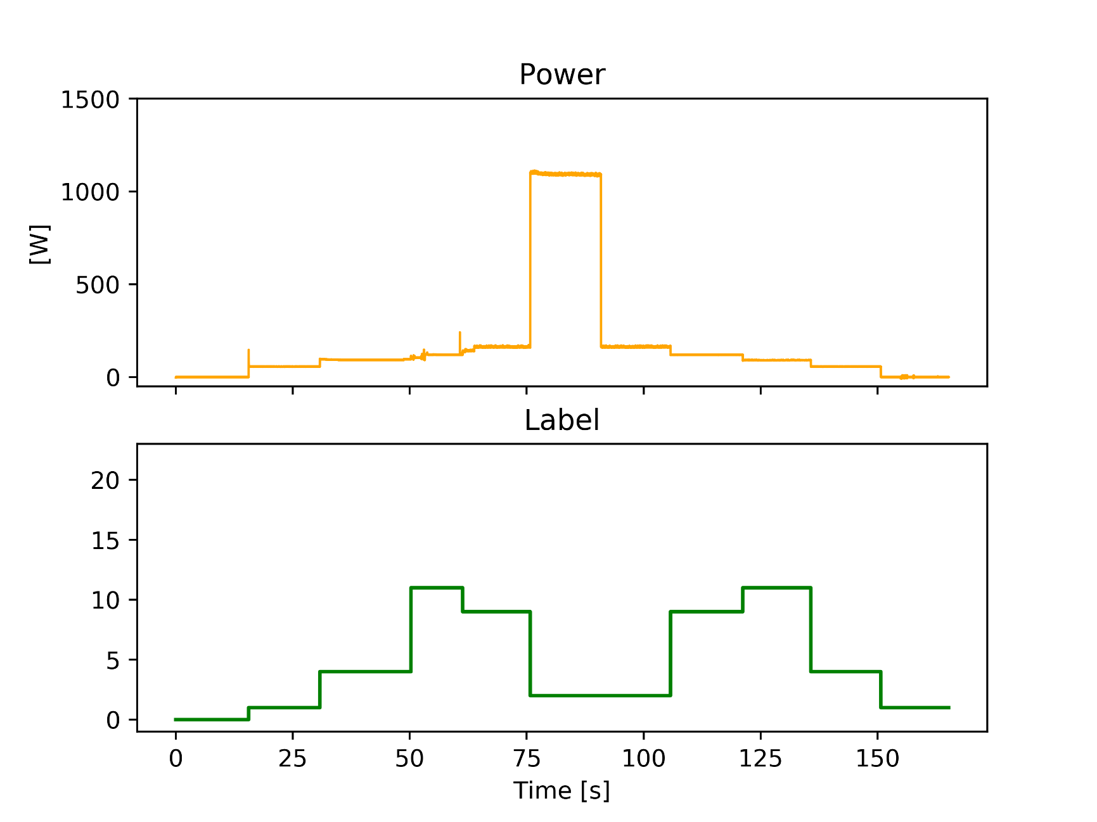
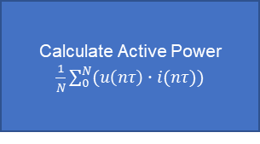
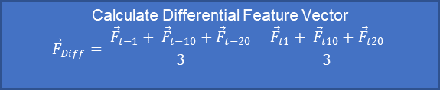
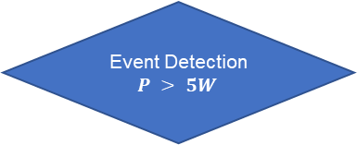
Event-based Classification
Dataset is labelled differently here
The labels here signify load state change.
Event Detection and Feature Extraction Algorithm
Measure Voltage & Current for 100ms
Calculate Active Power $\frac{1}{N}\sum_{0}^{N}{(u\left(nτ\right)∙i(nτ))}$
Event Detection
$$P > 5W$$
Calculate Differential Feature Vector
$${\vec{F}}_{Diff}= \frac{{\vec{F}}_{t−1}+ {\vec{F}}_{t−10}+{\vec{F}}_{t−20}}{3}−\frac{{\vec{F}}_{t1}+ {\vec{F}}_{t10}+{\vec{F}}_{t20}}{3}$$
Append to Dataset
1
4
11
9
2
2
9
11
4
1

Slide 14
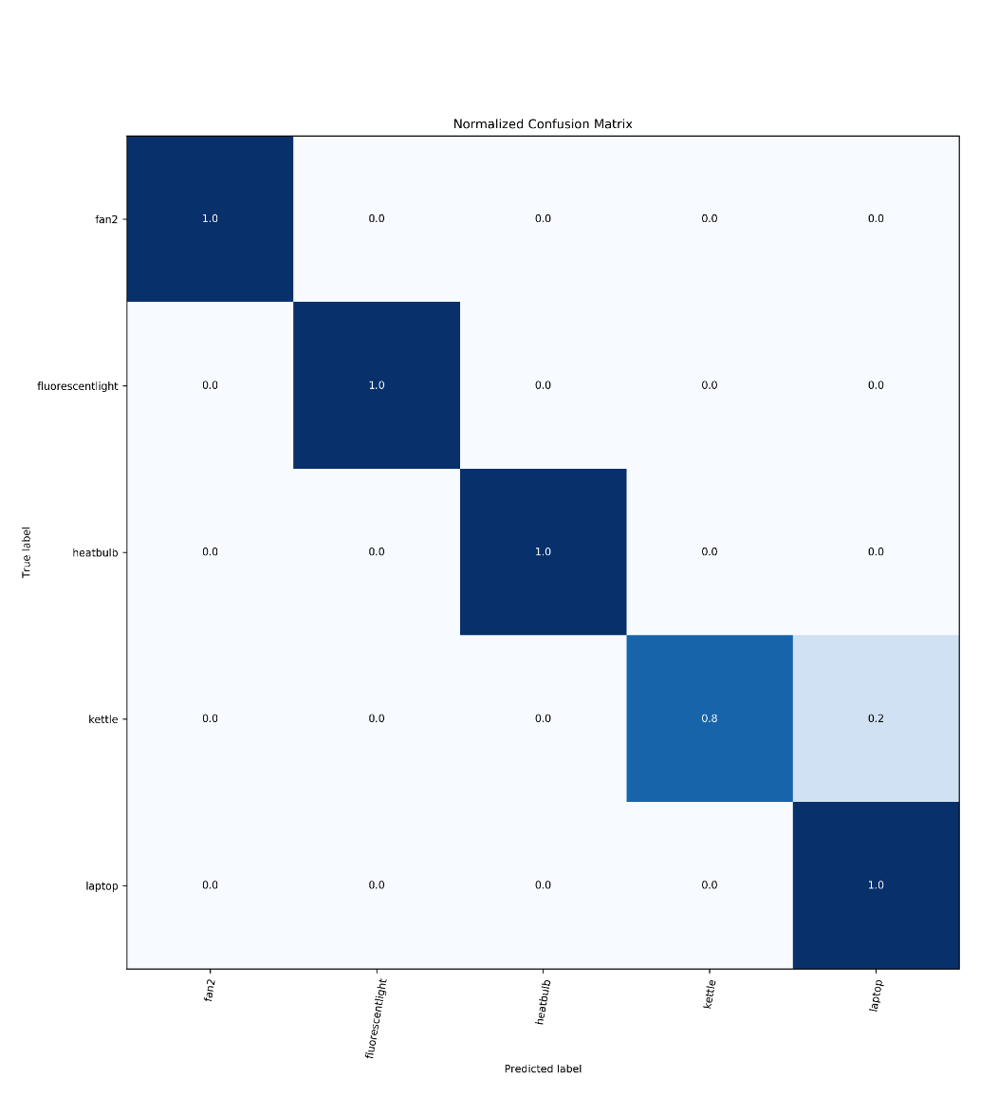
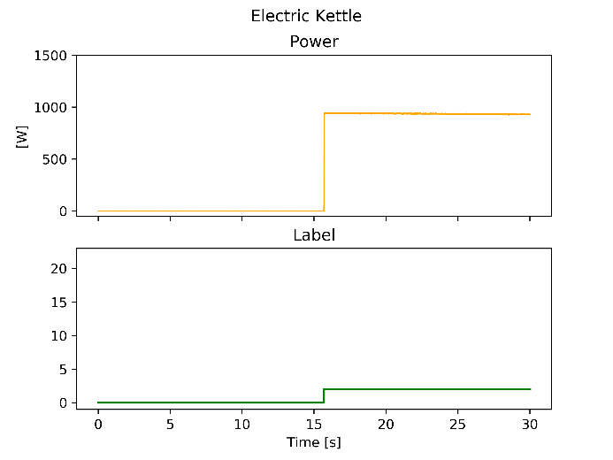
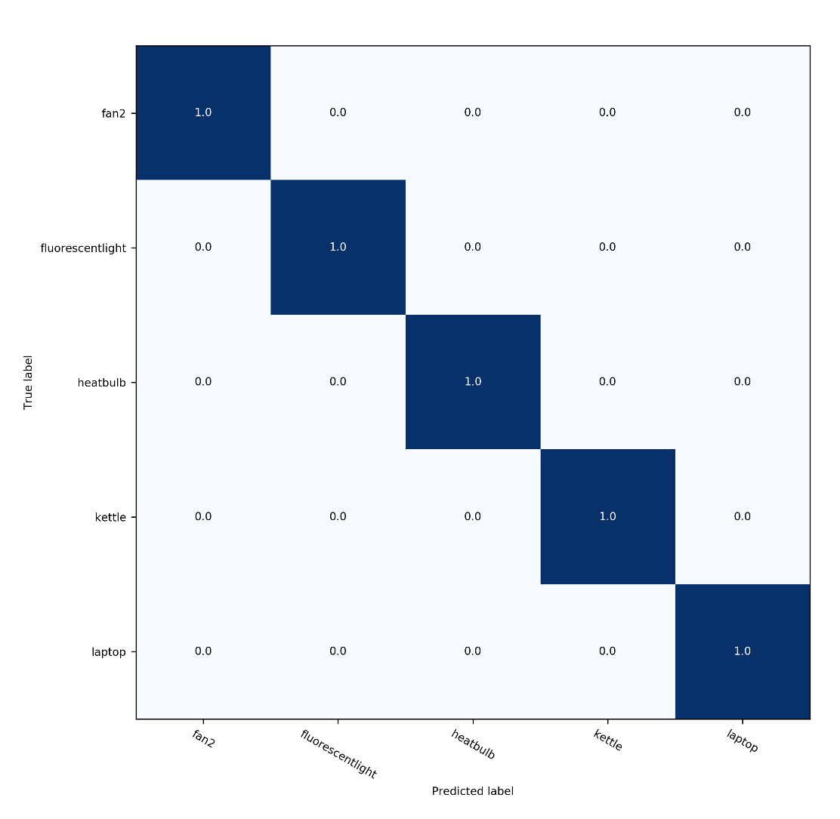
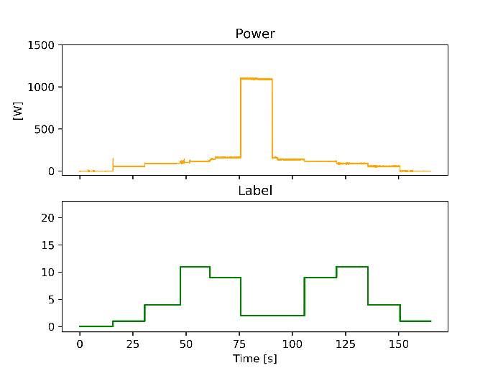
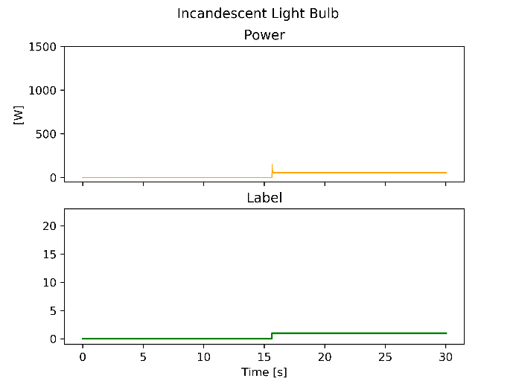
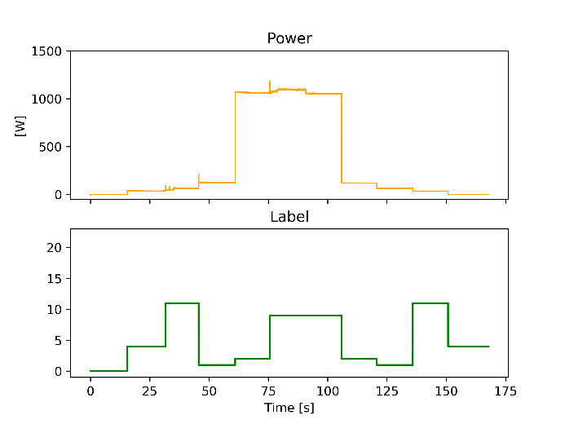
Evaluation 2: Eventless Classification
Best Classification with Random Forest Tree @ Max Leaf Nodes: 50, Min Samples Leaf: 1, ‘N Estimators': 1000 with 5 Classes
On Test Dataset of Model
Confusion Matrix
On Scenario 3
Confusion Matrix
Accuracy= 100.00%
Precision= 100.00%
Recall = 100.00%
F-Beta Score = 100.00%
Accuracy= 90.91%
Precision= 93.94%
Recall = 90.91%
F-Beta Score = 90.30%

Slide 15
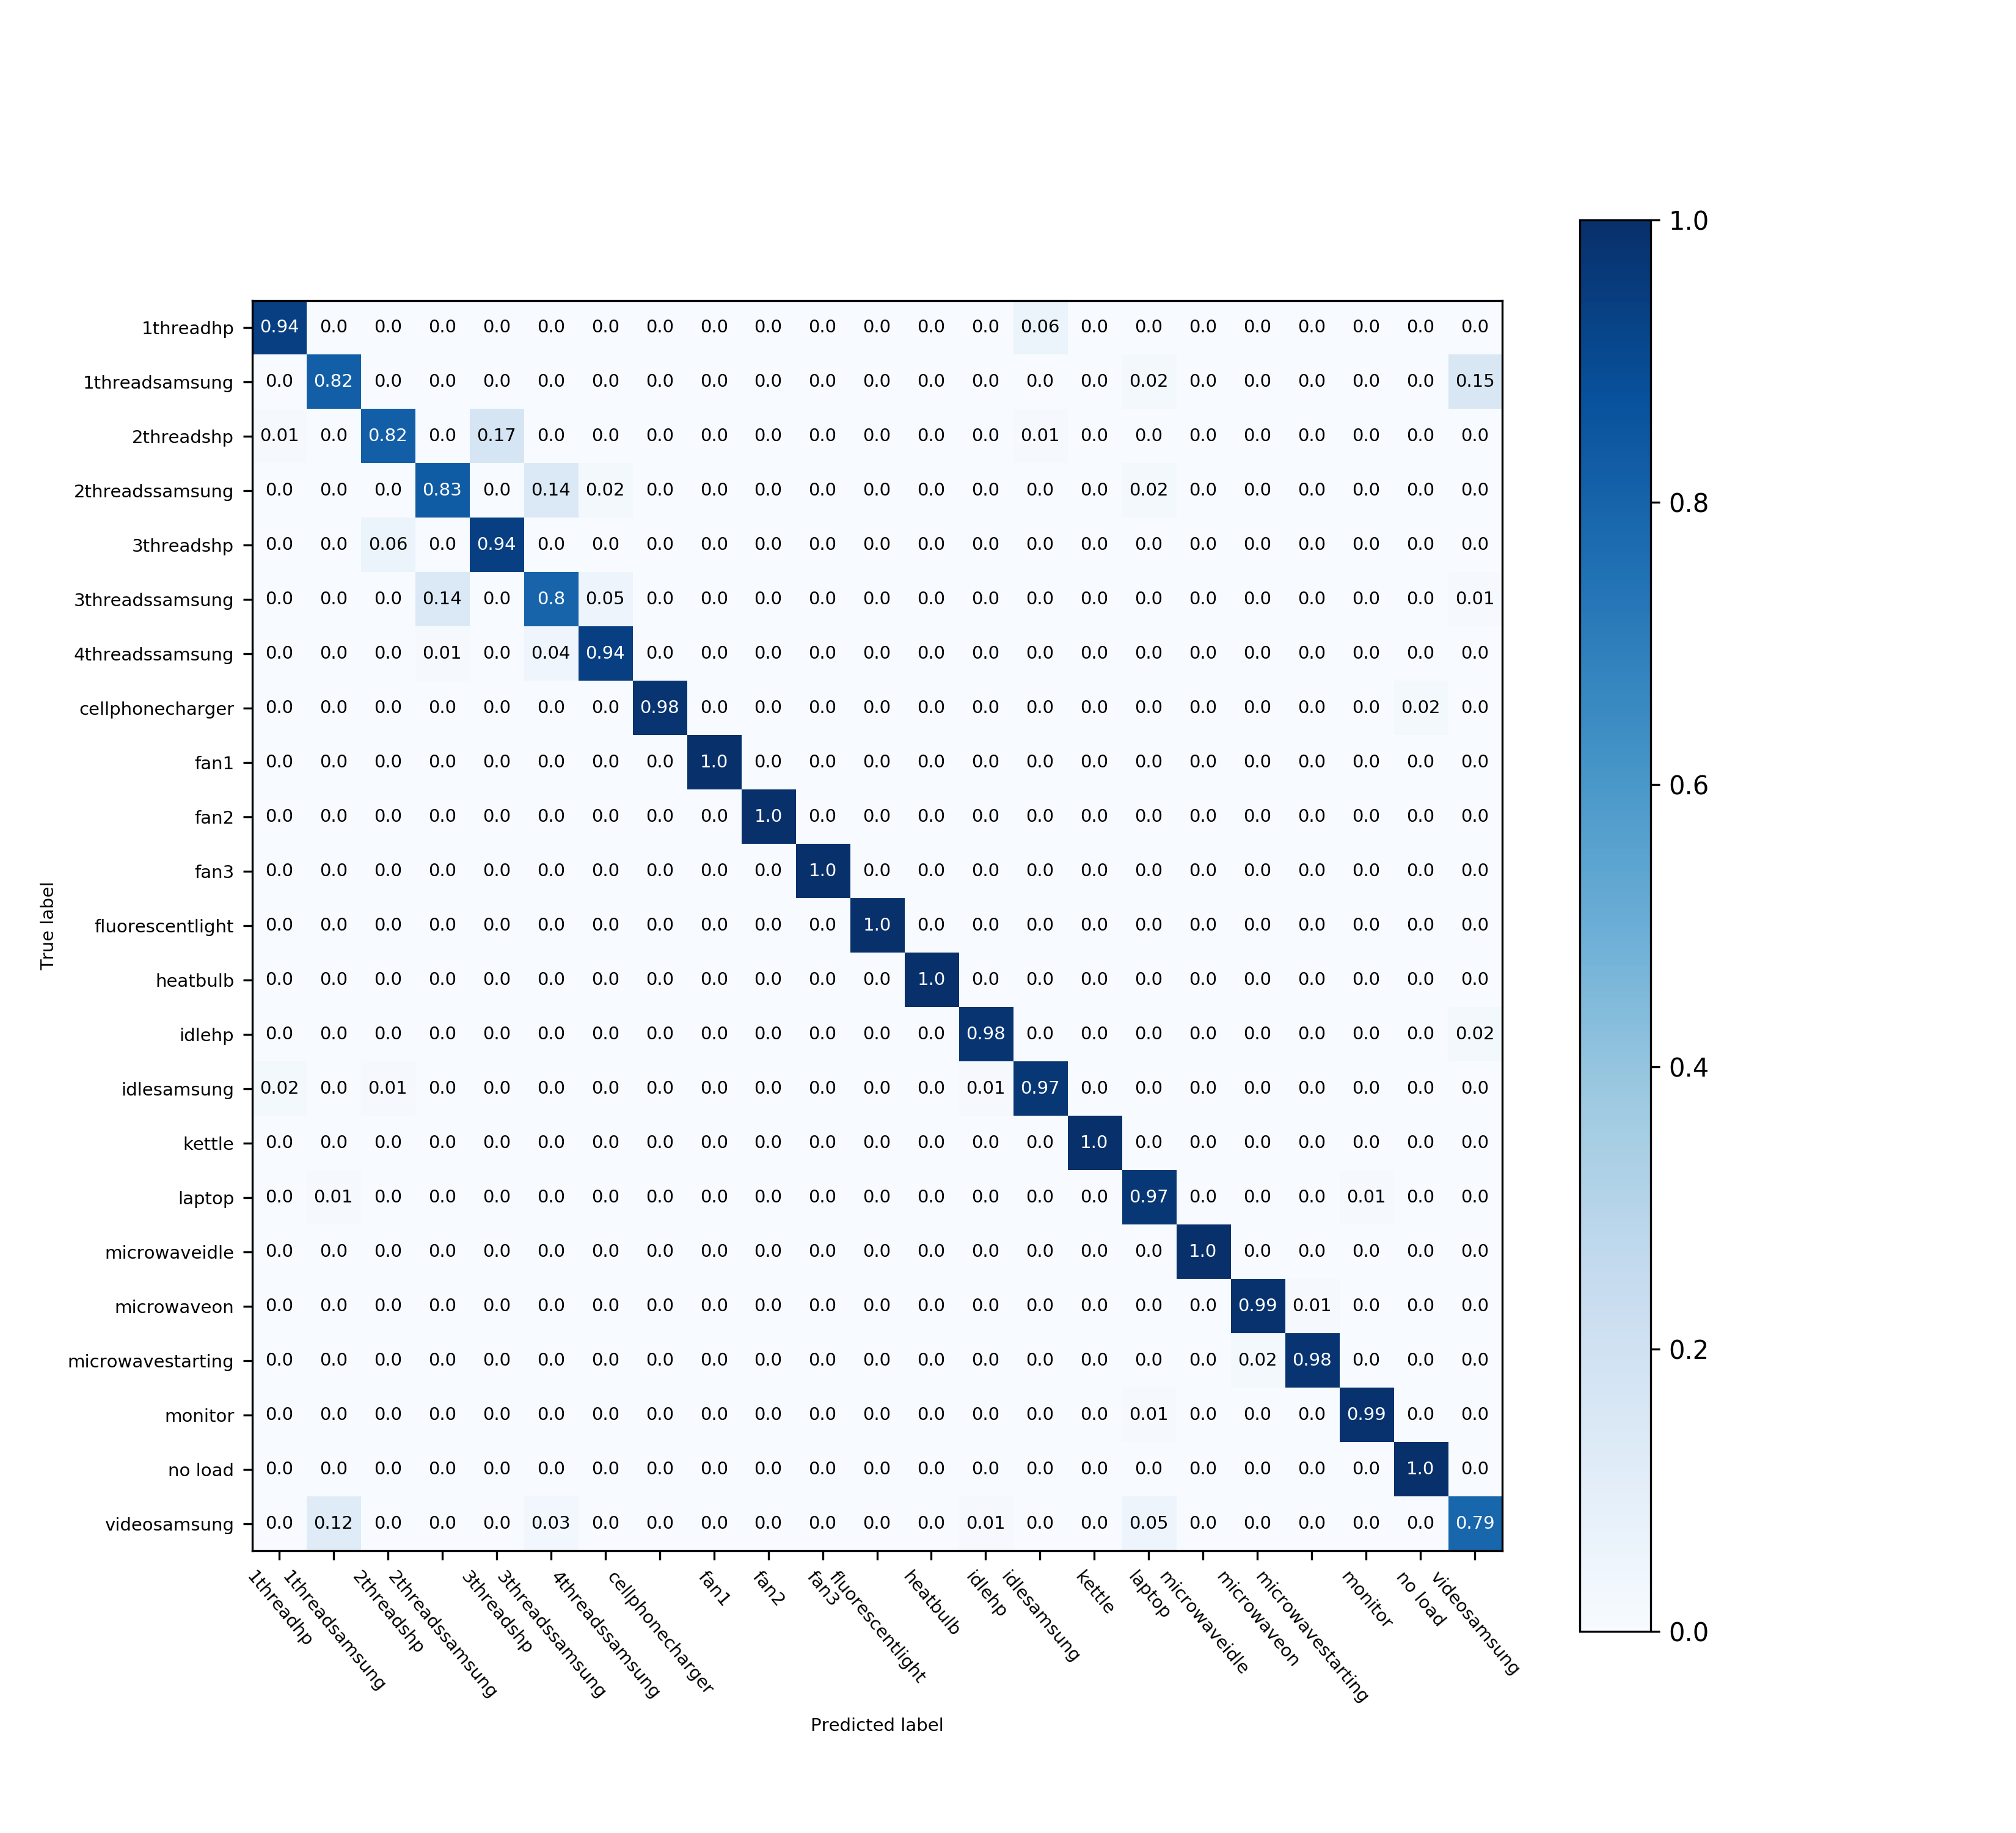
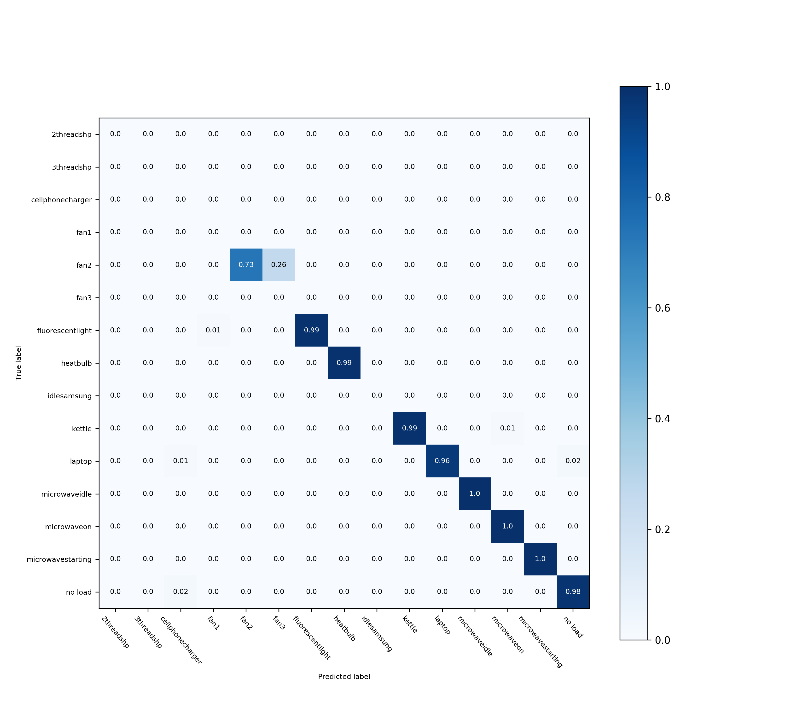
Evaluation 3: Extended Eventless Classification
Best Classification of 23 Classes with SVC @ C=1, gamma = 0.0001 and a linear kernel.
MLP-Classifier, Random Forest Trees and k-NN perform also similar
On Test Dataset of Model
On Scenario 3.1
Normalized Confusion Matrix
Normalized Confusion Matrix
Accuracy= 97.01%
Precision= 97.03%
Recall = 97.01%
F-Beta Score = 97.01%
Accuracy= 96.01% Precision= 99.63% Recall = 96.01% F-Beta Score = 97.62%

Slide 16
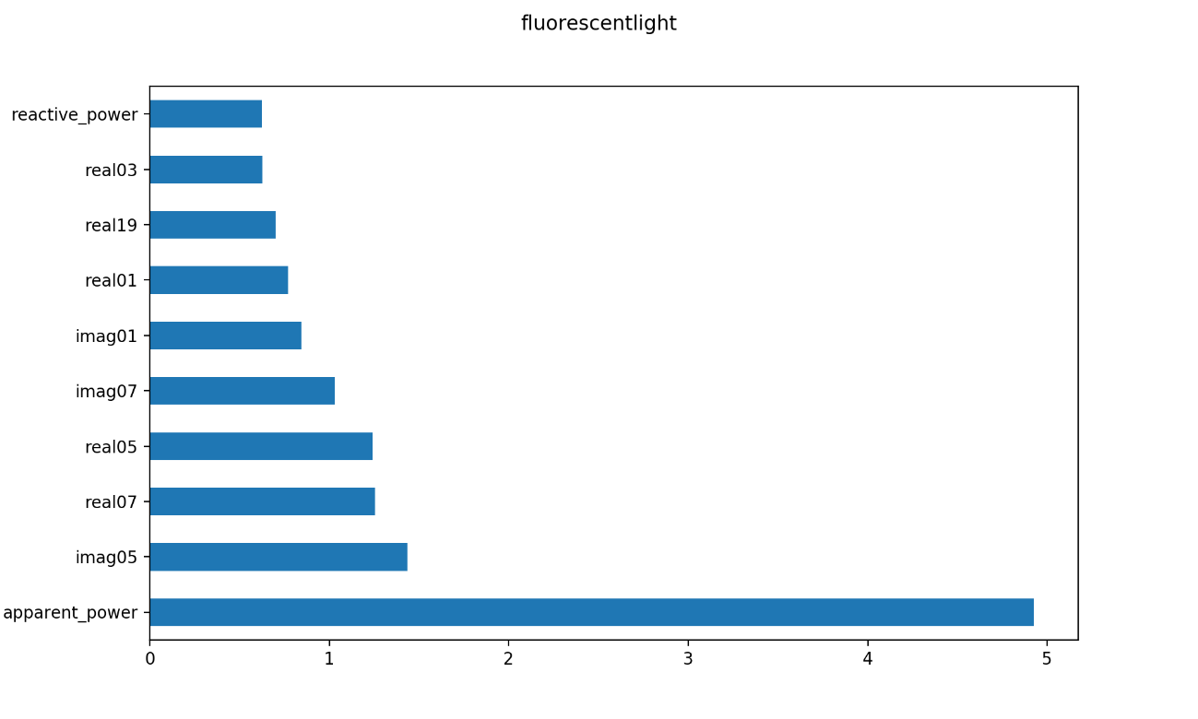
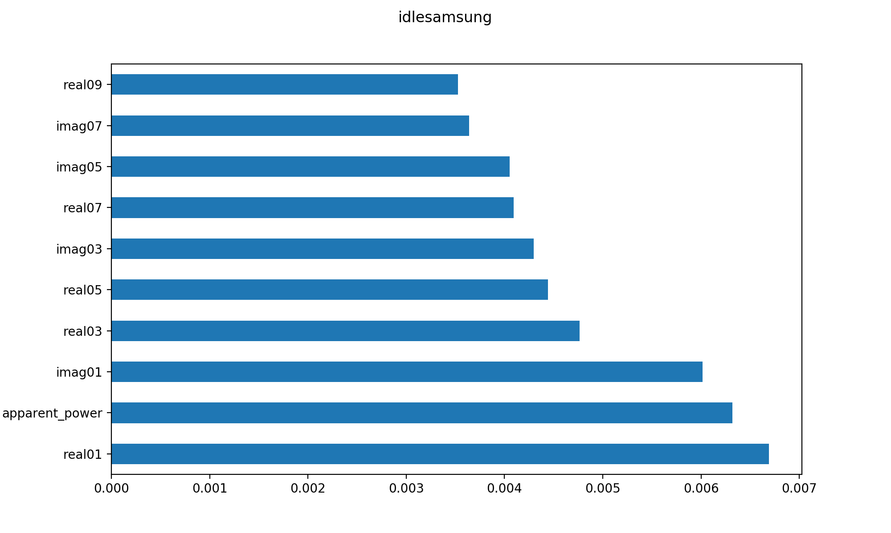
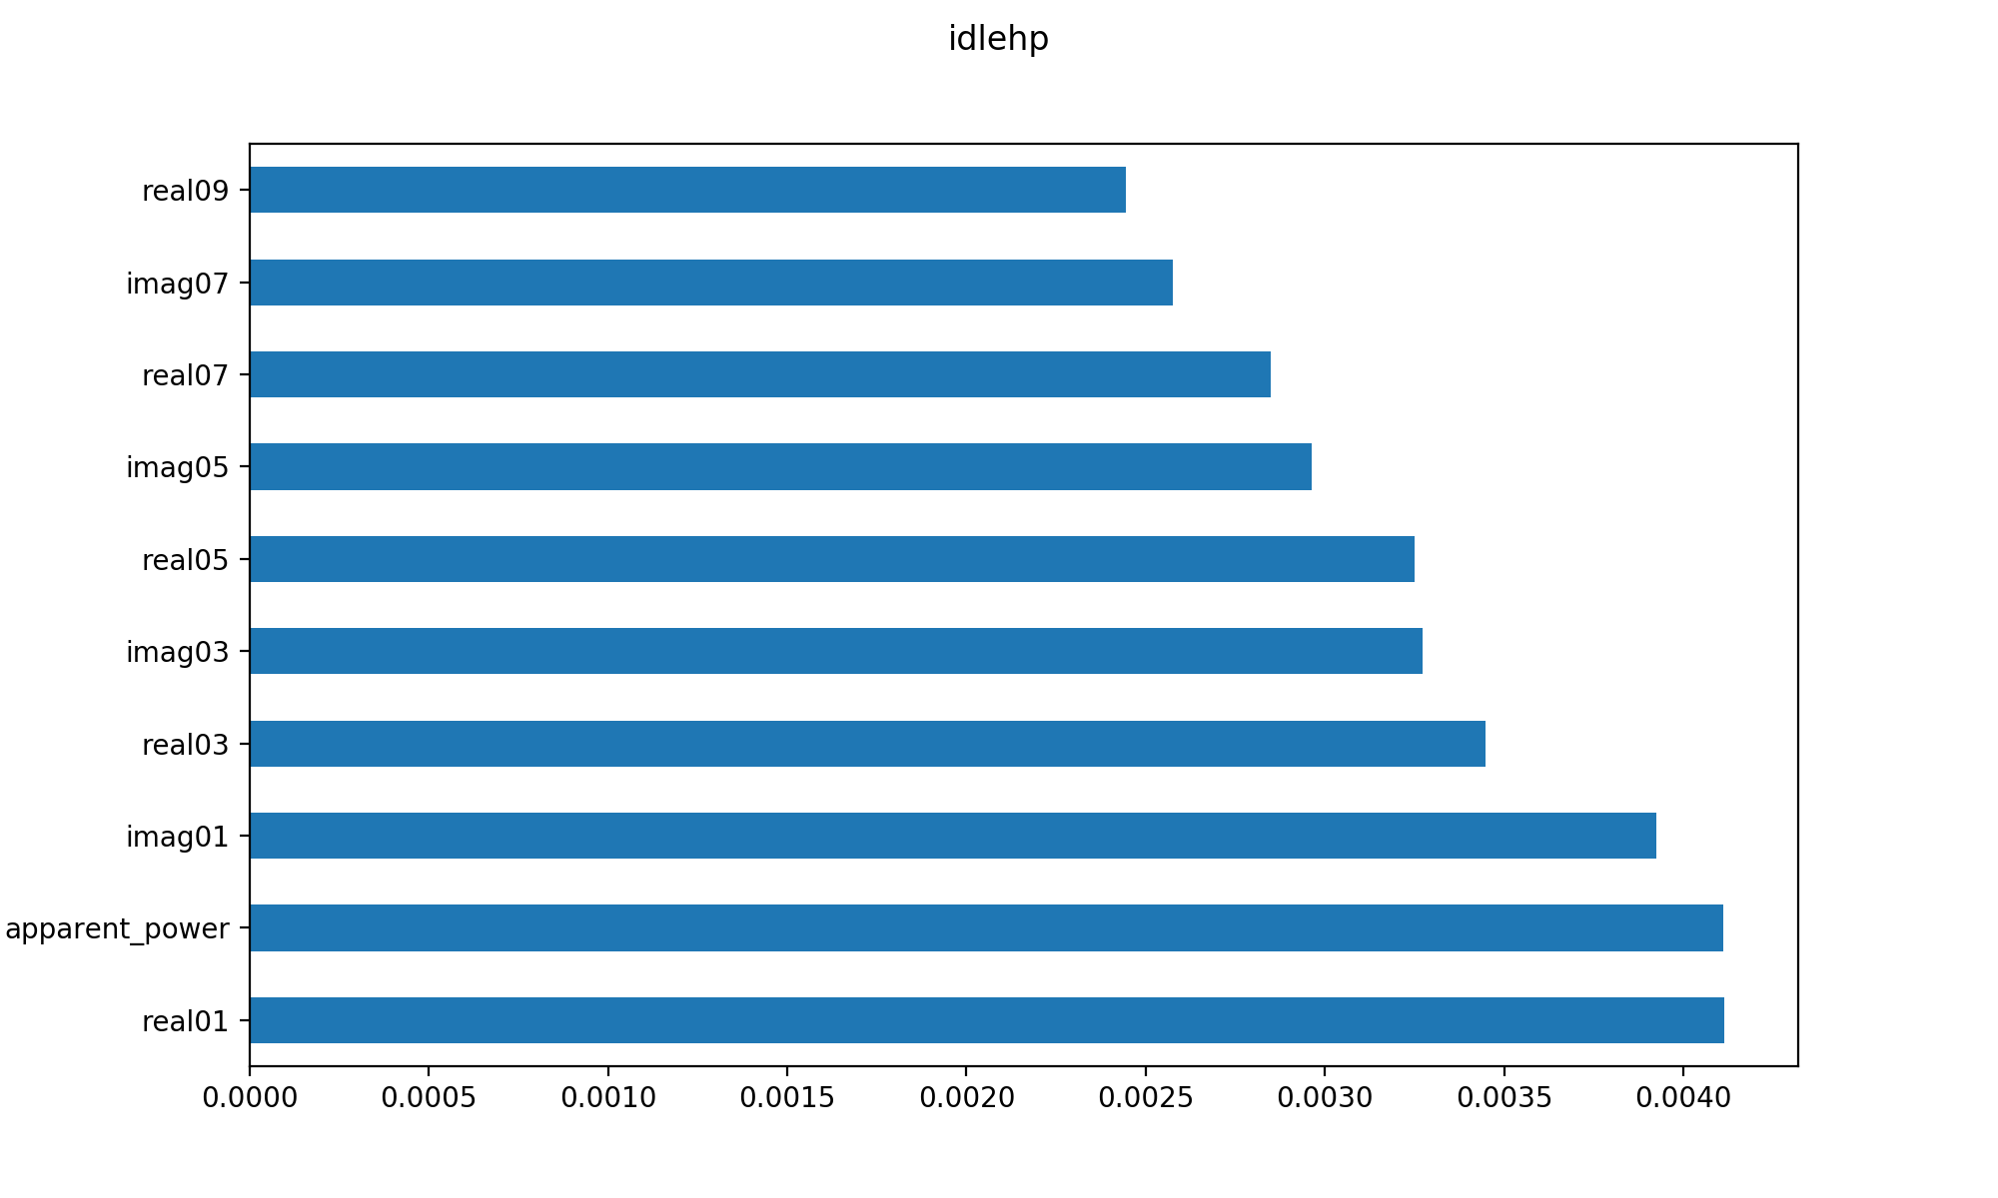
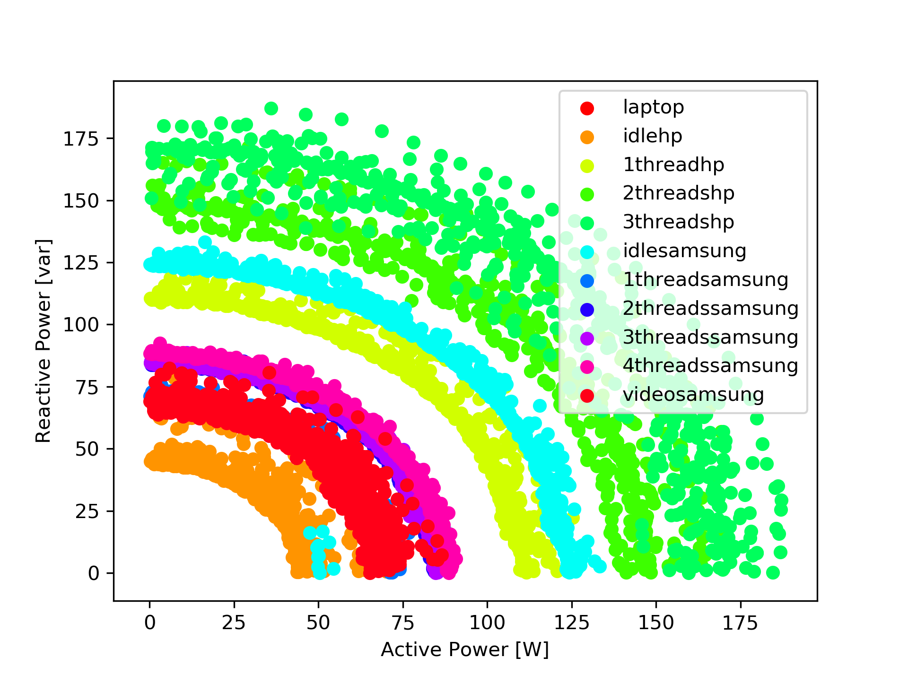
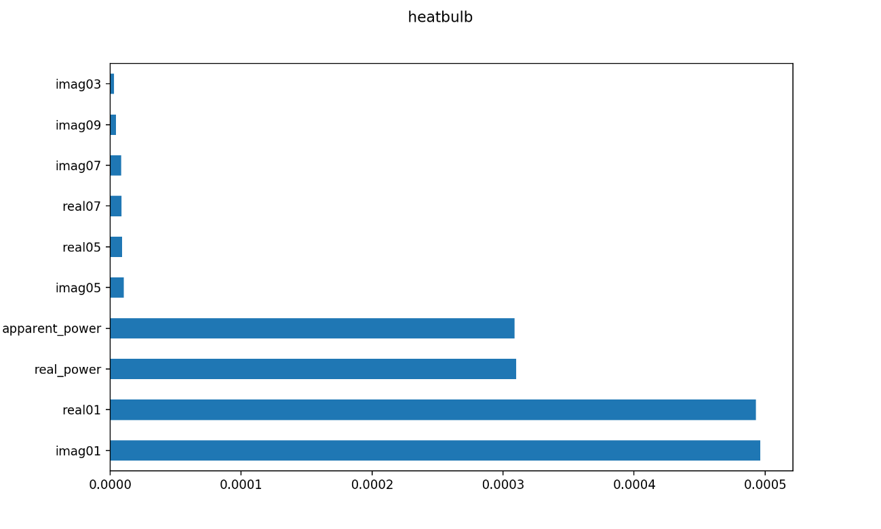
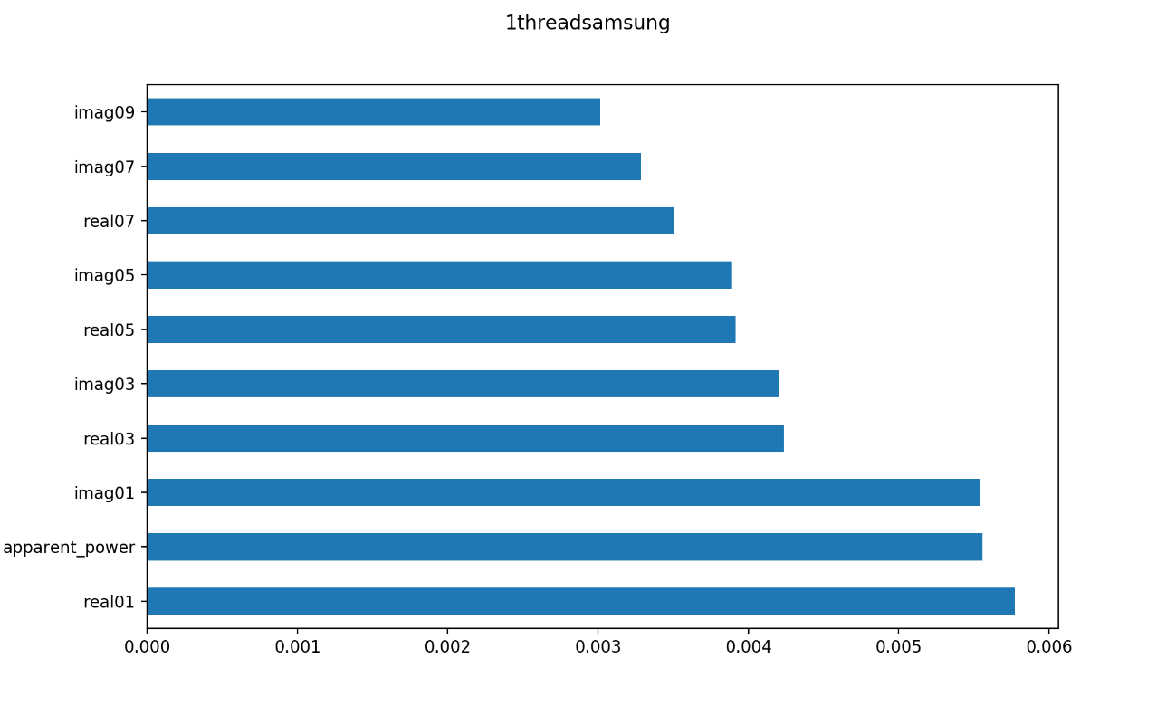
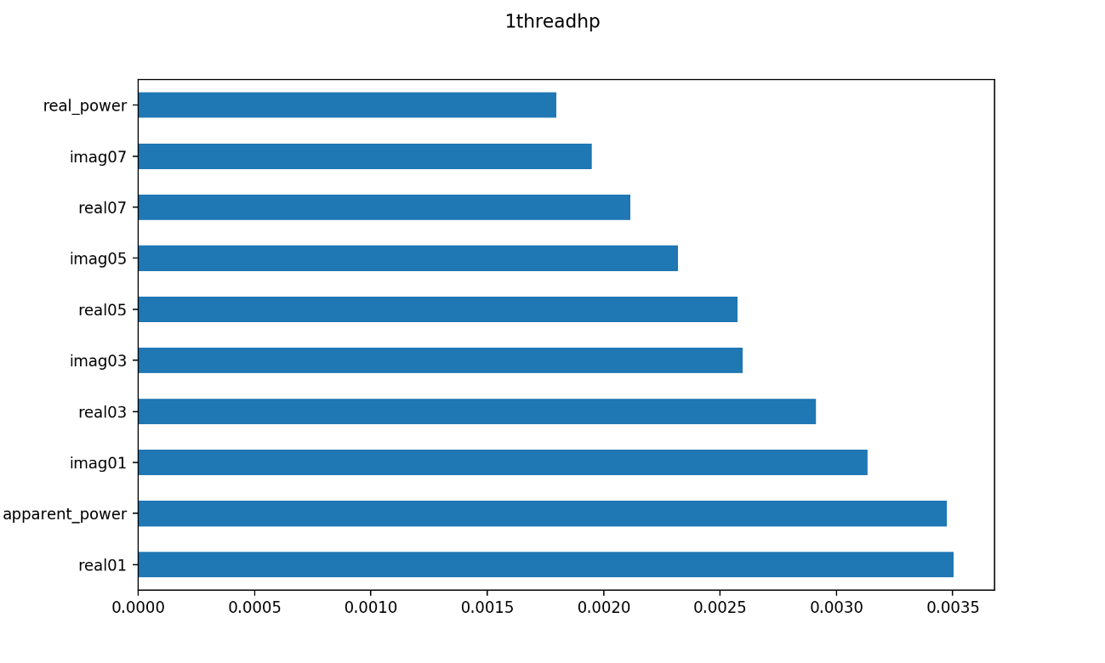
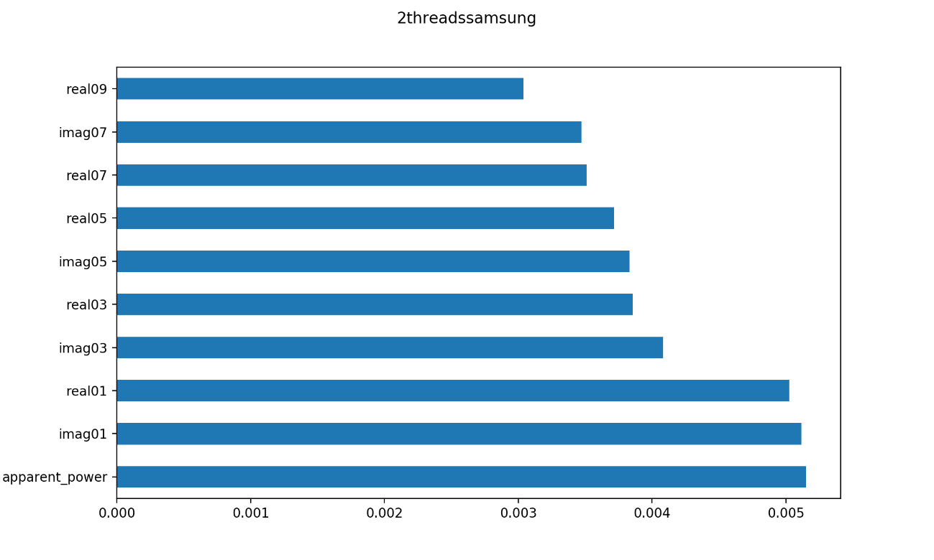
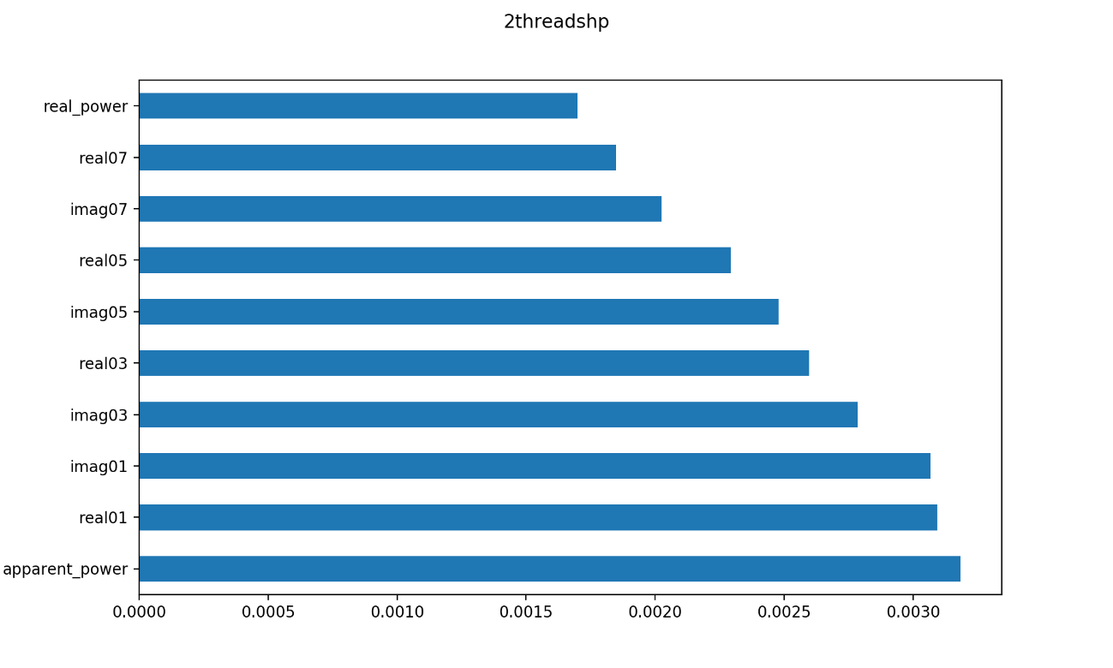
Evaluation 3: Feature Weights for different Appliances

